Slide 1
Web Programming (CSC 4370)
Final Project
Ivana Lanzani

Slide 2
Proposal
For my final project, I designed a Harry Potter Trivia game to play online. The game is a website that consists of three different screens that are decorated with the Harry Potter theme; a welcome page, a login page and a quiz page. The welcome page greets the user and displays the theme of the game. The login page checks the user’s credentials which are fixed in this website. Finally, the quiz page has the questions the user has to answer to score points. The user can easily navigate through all three pages with the use of buttons and answer the questions that are given in a multiple choice format. The game collects the correct answers and displays the final score after the last question is answered.
For the design of these websites, I used HTML, Javascript for most of the game application, CSS for styling the pages and PHP for authentication.
I would like to add that for next steps and improvement of my prototype, I plan to scale the website to record multiple rounds of the game and keep scores in a database to be able to declare a winner among all the players and store users and their passwords. I originally planned to include this step in the demo but, unfortunately, I encountered many mistakes that I was not able to resolve, which is why I decided to leave the multiplayer version out.

Slide 3
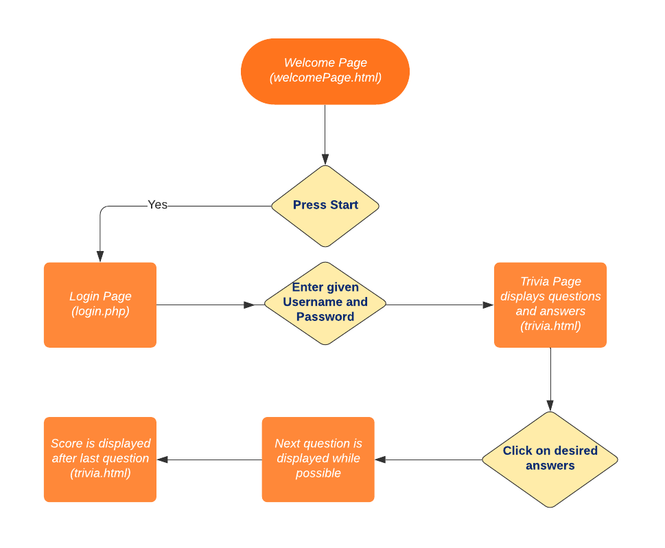
Idea : Trivia Game

Slide 4
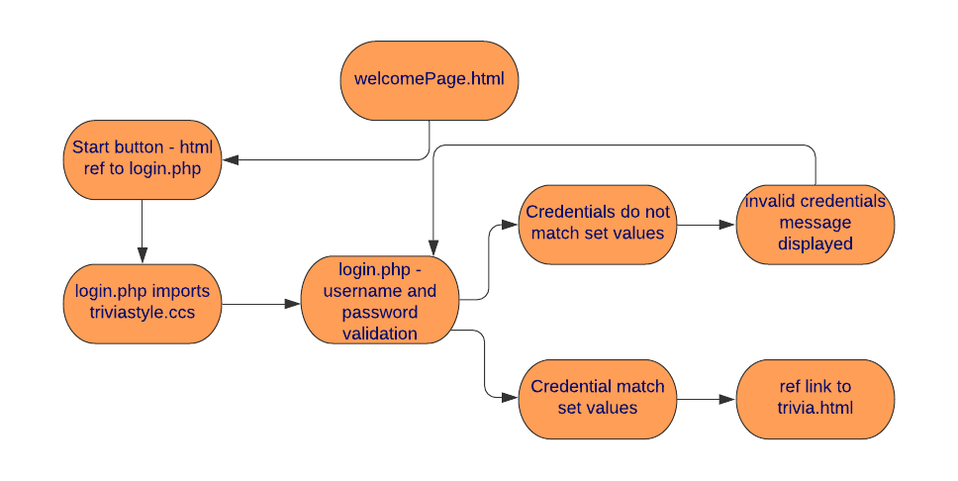
Detailed Diagram - Part 1

Slide 5
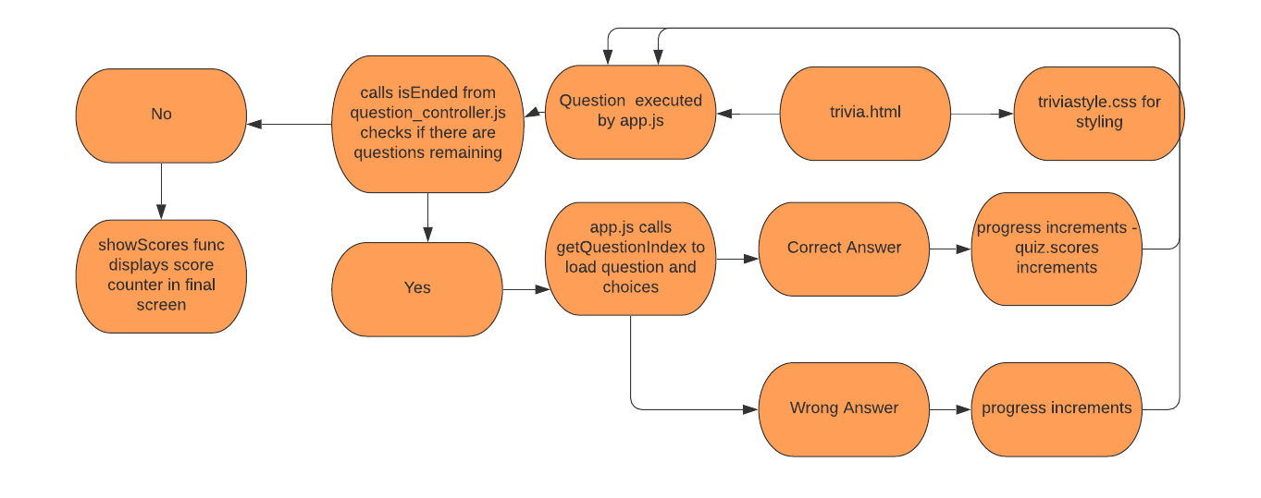
Detailed Diagram - Part 2

Slide 6
Welcome Page

Slide 7
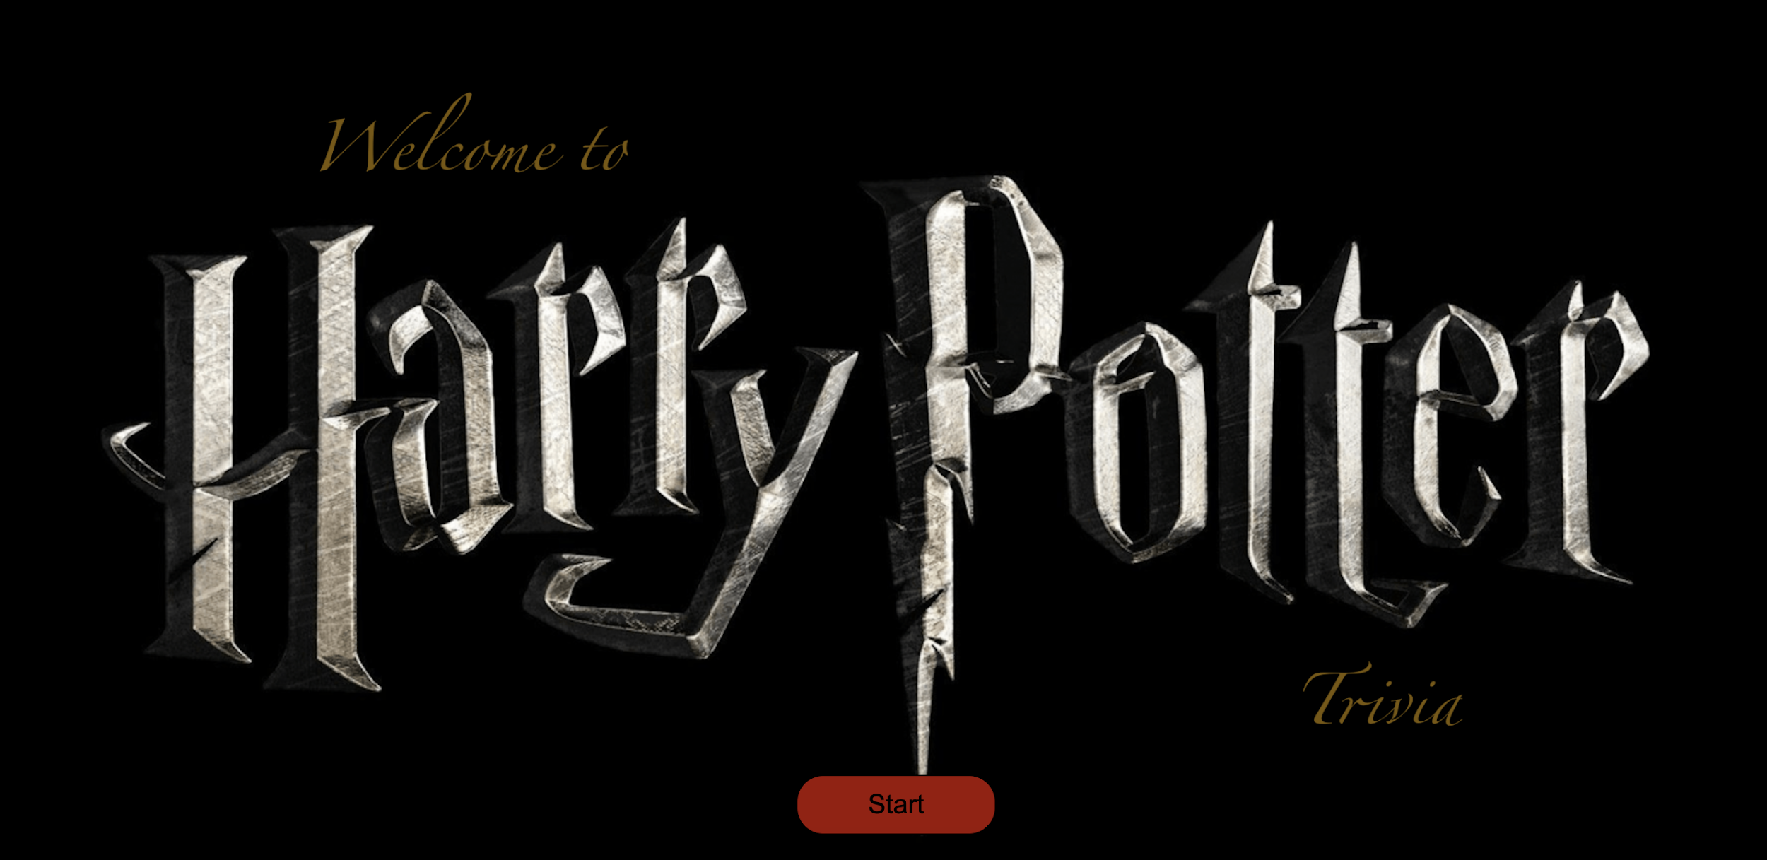

Slide 8
Login Page

Slide 9
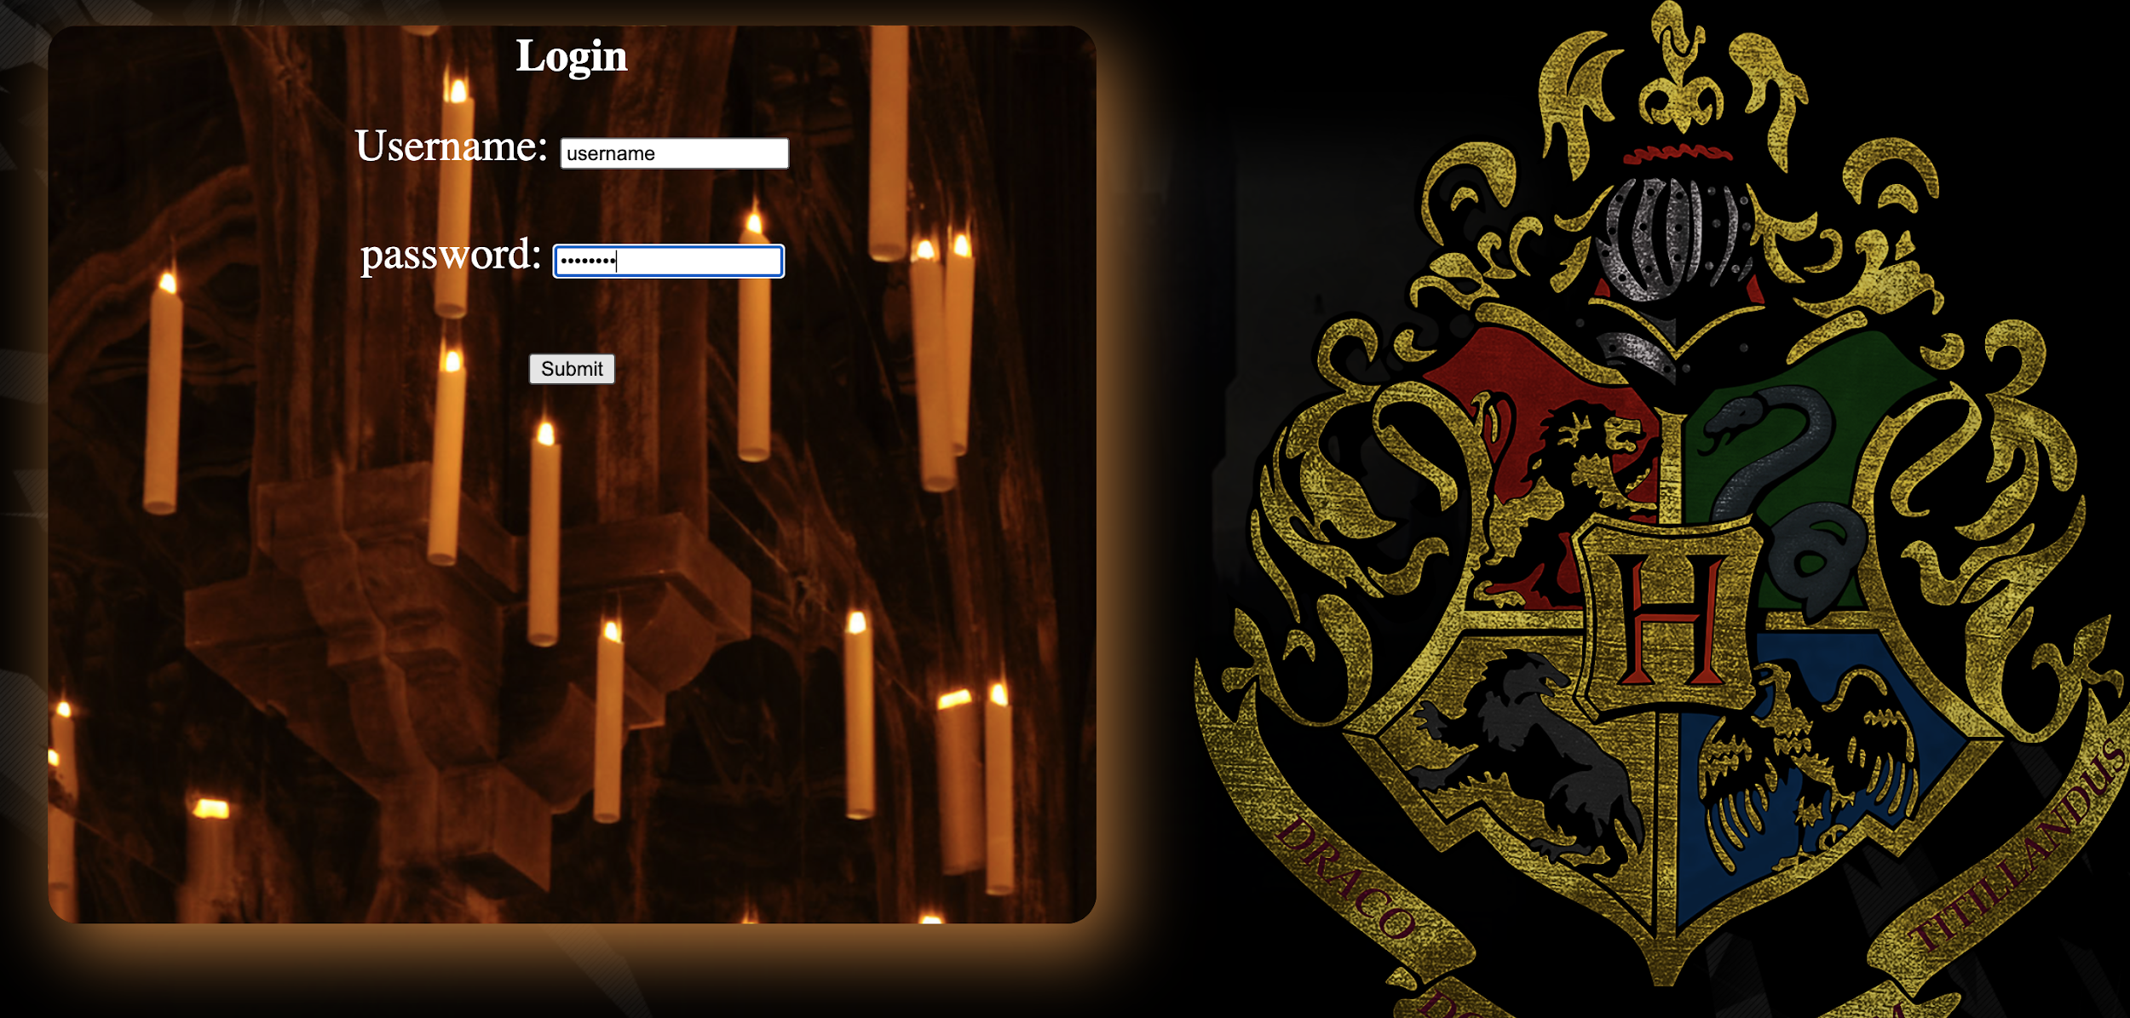

Slide 10
Trivia Page

Slide 11
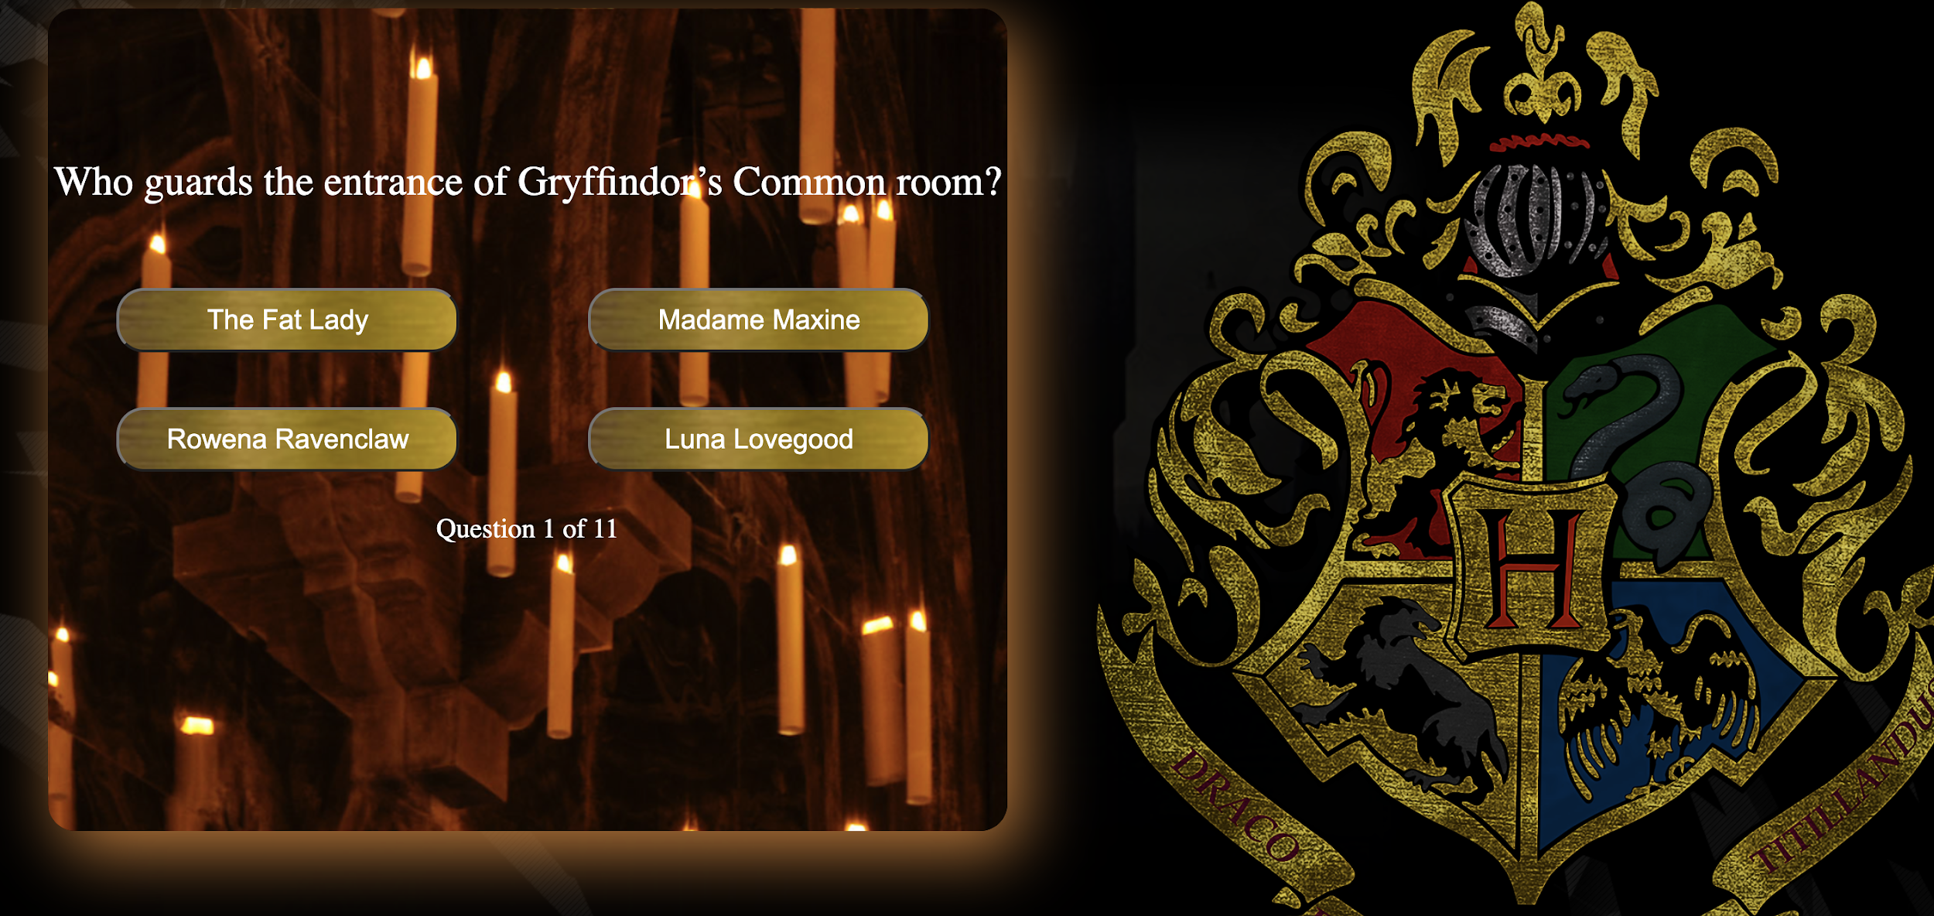

Slide 12
Results Page

Slide 13
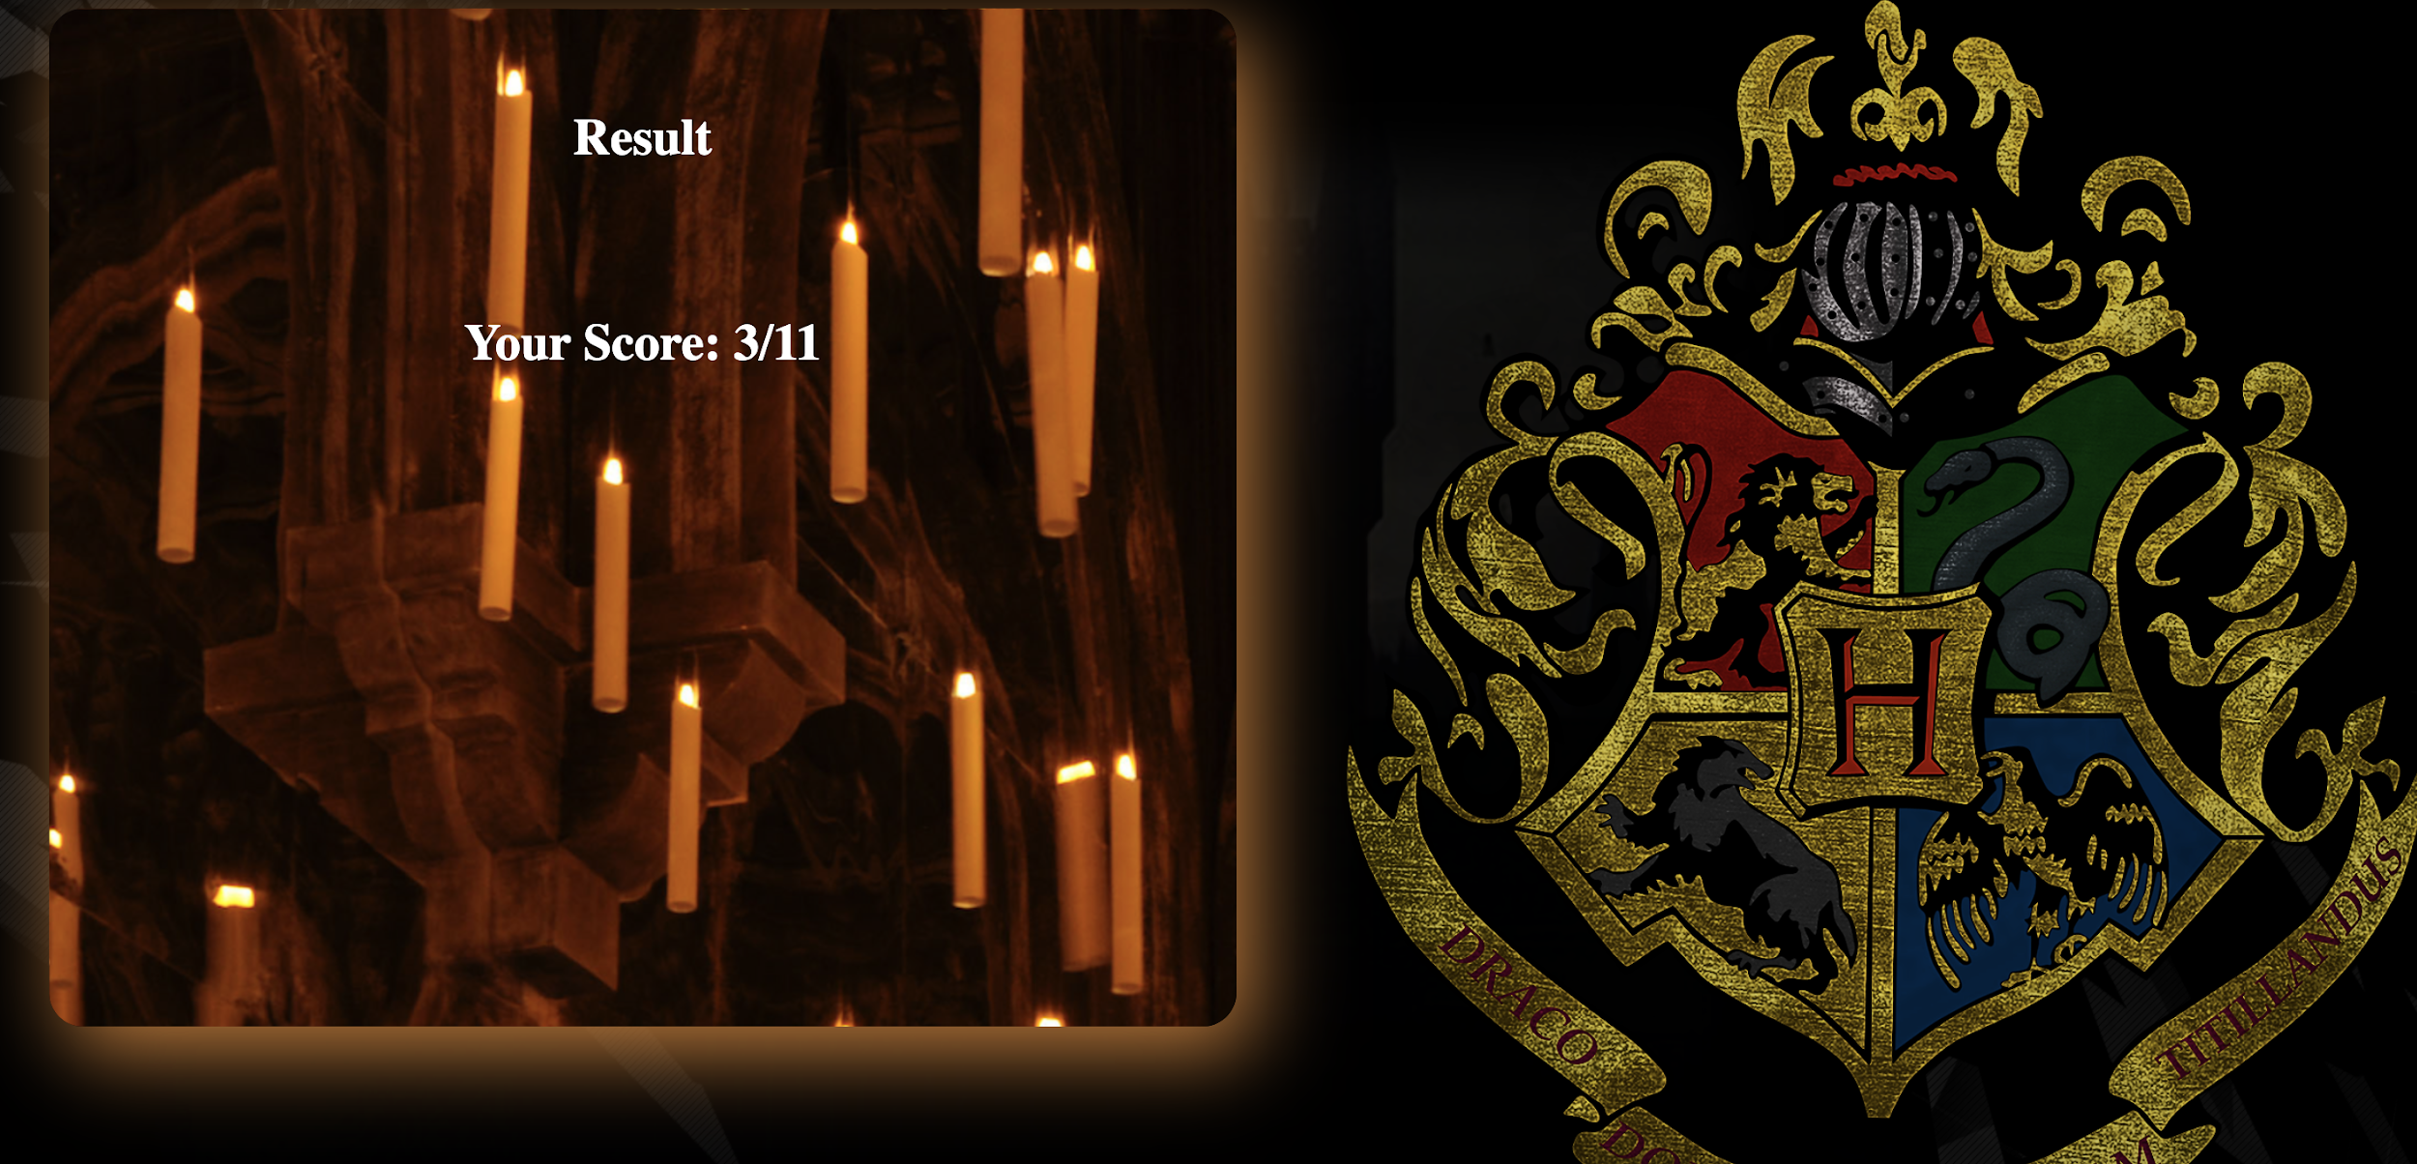

Slide 14
Links
Application: https://codd.cs.gsu.edu/~ilanzani1/WP/Assignments/finalProject/welcomePage.html
Credentials:
Username: username
Password: password
Video: https://www.youtube.com/watch?v=_Pg_kcnqM1k&feature=youtu.be
GitHub: https://github.com/ilanzani1/WP_FinalProject

Slide 15
Sources
https://www.w3schools.com/
Class Slides and Videos
CSS Color Palettes: https://freefrontend.com/css-color-palettes/

Slide 16
What’s your score?

